Slide 1
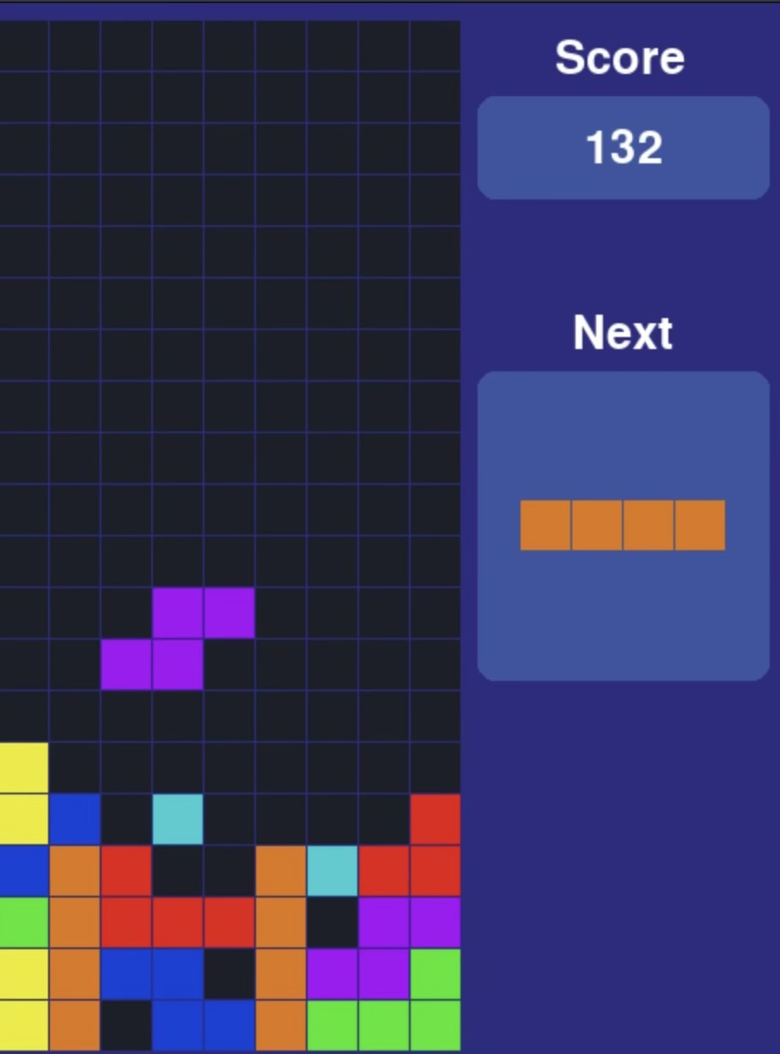
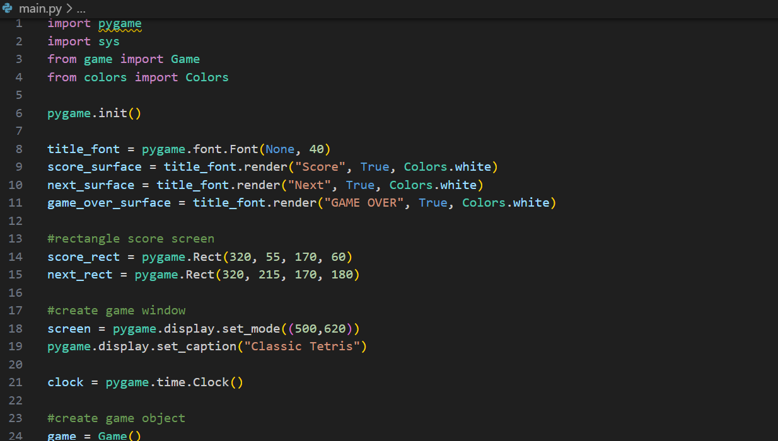
Timeless Tetris
Axel Galdamez
I took an already established Tetris game and modified it to my personal liking, while making it more vibrant and smoother to play.

